Slide 1
Hackathon Presentation - Who will Claim it ?
Data Ultrons
Sagar Bhadra
Debapriya Roy
Vishal Kashyap
Kanksha Dhakate

Slide 2
Problem Statement
Insurance companies take risks over customers. Risk management is a very important aspect of the insurance industry. Insurers consider every quantifiable factor to develop profiles of high and low insurance risks. Insurers collect vast amounts of information about policyholders and analyze the data.
As a Data scientist in an insurance company, we need to analyze the available data and predict whether to sanction the insurance or not.
Notes:
Can we include some examples here?

Slide 3
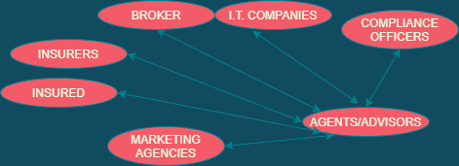
Stakeholders

Slide 4
Why solve this problem?
Solving this problem helps in risk management and identifying potential customers. With the help of high-level key insights, insurers can reach out to such customers and provide personalized attention to address their concerns in time.
Addressing of pain points of customers: Price discrimination
Advantages/ perks to the third party companies who fulfil the criteria or target.
Transparency and judgement
To CEO and Marketing for target Marketing and developing new guidelines on Policy selling and Premium Amount revision based on the findings of Claim ratio of the products .
Also introducing schemes/offers in destinations where insurance claim is low , so that more people buy the policy but don’t require to claim.

Slide 5
Additional data
Q - If you had the opportunity, what additional data you would love to have?
Additional Features | Short Description
Date-Time | Can be used to identify claim seasonality.
Gender | This feature might add an interesting angle to decide the dependency factor to claim.
Travel Class | For eg : Economy/Business/First Class can be used to identify the group of people which has the maximum claim ratio.
Claim History | Can be used to identify people prone to Claim (insurance fraud)
Notes:
a

Slide 6
Exploratory Data Analysis
Data Conversions
1 - Wherever we had negative Net sales, we converted it to 0 and wherever we had Net sales 0, we simply converted commission to 0.
2 - We created another column by grouping “Destination” column into “Continents”.
3 - We also grouped Age column and created a bins of age. for eg : 0-30,31-60 etc.
4 - We added a Destination Level Risk(index) Feature which resembles which country/destination has the highest level of Claim risk.

Slide 7
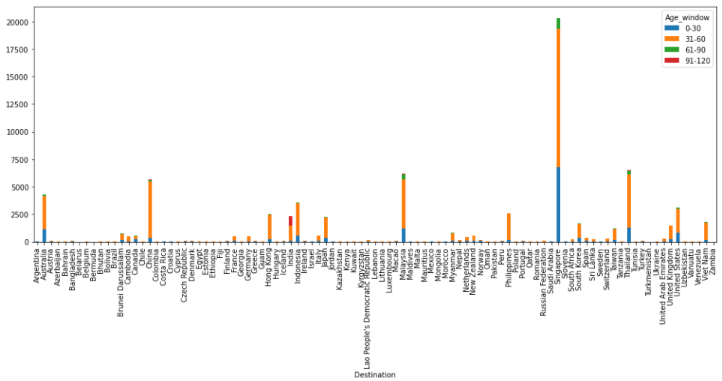
Destination Vs. Age

Slide 8
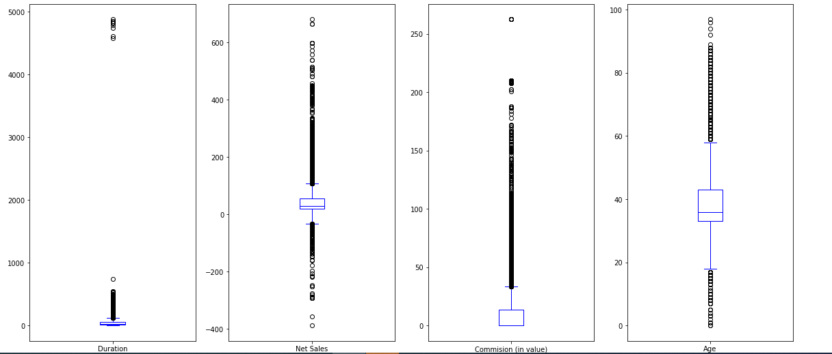
Numerical Features :

Slide 9
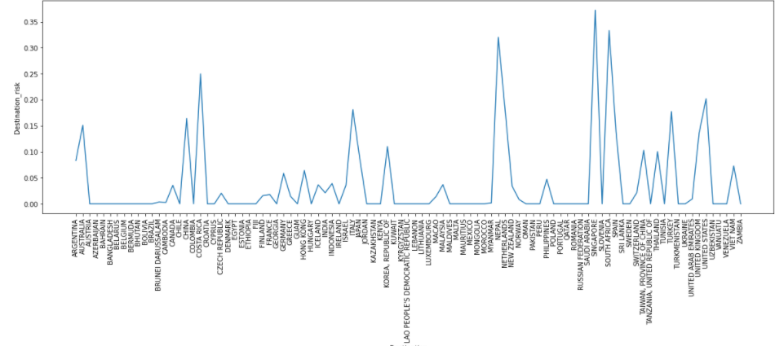
Destination Risk Modelling

Slide 10
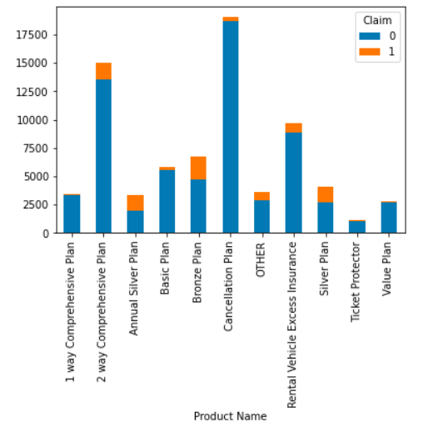
Insights
Data Visualizations
1 - Which product have maximum claim ratio?

Slide 11
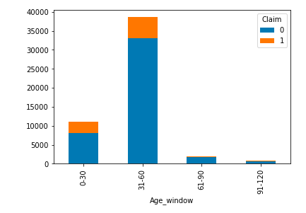
2 - Does Age play a deciding factor in Claims?

Slide 12
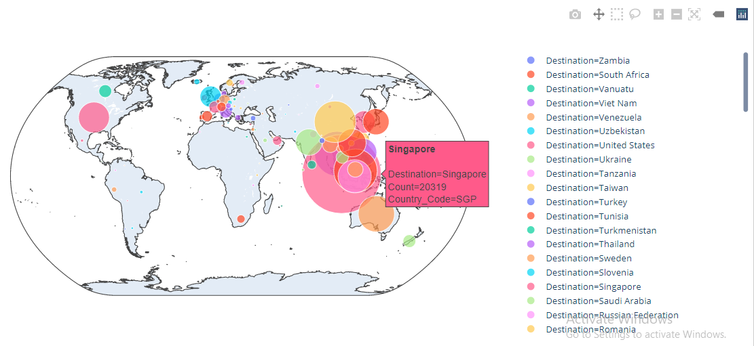
3 - Which countries have the maximum visitor count?

Slide 13
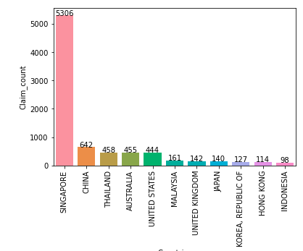
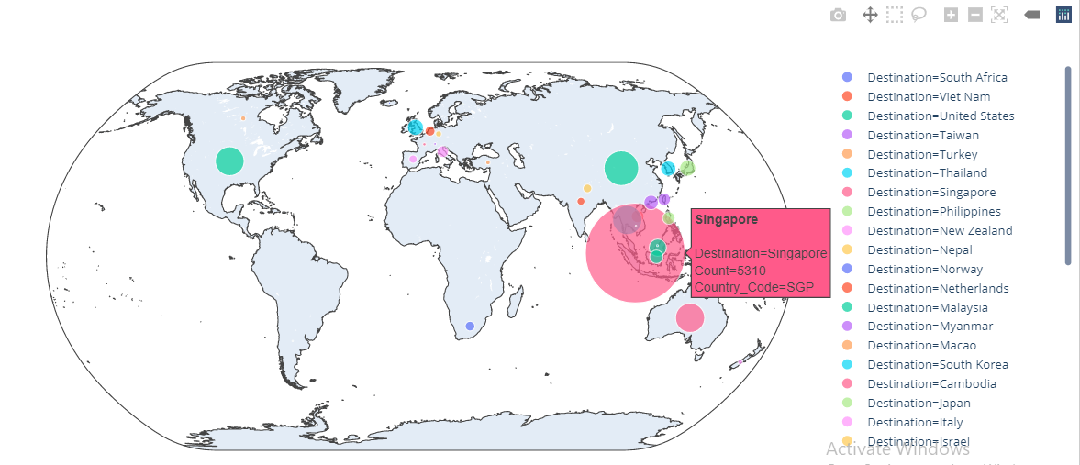
4 - Whether a specific country has the maximum insurance claim or is it inconclusive?

Slide 14
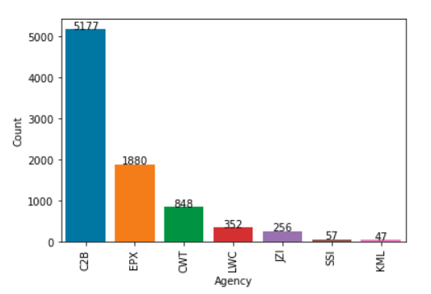
5 - Insured claims by Agency type?

Slide 15
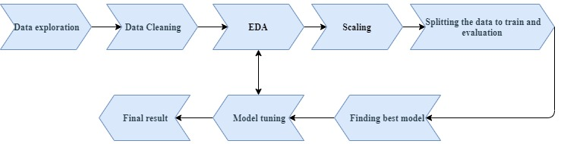
Pipeline :
Steps to our solution :

Slide 16
Models and Approaches :
Models we Tried :
●Extra Trees
● Random Forest
● Decision Tree
● XGBoost
Best Model Performance: Extremely Randomized Trees Classifier(Extra Trees Classifier) It is a type of ensemble learning technique which aggregates the results of multiple de-correlated decision trees collected in a “forest” to output it’s classification result. In concept, it is very similar to a Random Forest Classifier and only differs from it in the manner of construction of the decision trees in the forest. Libraries/Functions used in Model HyperParameter Tunning and Model Performance Comparative Analysis GridSearchCV and PyCaret 2.0

Slide 17
Model Tuning :
We used GridSearch for : criterion, n_estimators,bootstrap
ExtraTreesClassifier(bootstrap=False,
criterion='gini',max_features='auto',
min_samples_split=2,
n_estimators=100, n_jobs=-1)
Additional : Smote was used/tried to handle class imbalance on the target

Slide 18
Evaluation Metrics and Final Results
The final results of the best performing model among all the submissions.
score is 0.9592633658318996 Cross-validation mean accuracy is 95.5558238483157 Standard deviation of accuracy is 0.2979333321863067 . Accuracy score of Model is 0.9592633658318996 Precision score of model is 0.9565843593548679 Recall score of model is 0.9592633658318996 F1 score of model is 0.95174685105871694 ROC AUC score is 0.9537595513078891

Slide 19
Insights & Decisions :
●Customize Insurance Plans based on the Duration of Travel for a Person as chances of claims can be probably higher in a longer trip.
●Reason of trip should be taken into consideration while selling policies. (Business/Recreation)
●Details of other Insurances taken by the person can also be an important aspect in important business decision making

